Slide 1
Selection of Classroom Standards

Slide 2
With The Design Thinking Method

Slide 3
Hello!
I am Cory Klinge
Director of Technology
Richfield Public Schools
On Twitter @MrKlinge

Slide 5
Current Reality (Transitioning)
Power and Data
Antiquated low voltage outlet numbers.
5 data drops (3 wall, 2 ceiling)
At Least 1 Extreme Wireless AP
Display
K-8
Projector
6000 SMART board
9-12
Projector
Screen
Audio & Intercom
Califone portable speakers
Analog Intercom system

Slide 6
Impetus For Change
Improved Pedagogy
Integrated Systems
Building Improvements
Antiquated Hardware
We believe strongly in first establishing our “WHY”.

Slide 7
Process:
Design Thinking
Innovation Through A Deep Understanding of The Challenge

Slide 8
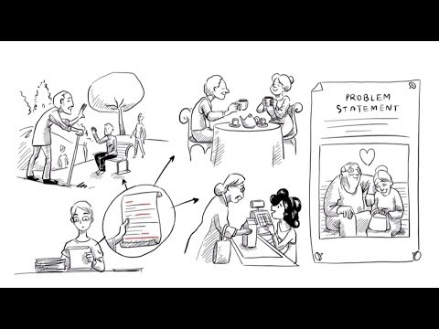

Slide 10
Tech Steering Committee
Who?
Teachers centered at buildings receiving a stipend to be leading integrators
Advisory committee with strong influence in change and adoption process.
How?
2-3 year process of utilizing the Design method to learn, and try prior to choosing.
This timespan allows for phasing, budgeting, and other logistics.

Slide 11
Design Thinking
Empathize
Define
Ideate
Prototype
Test
Repeat Steps 3-5
Utilize Committee To Gather Information .
Utilize Committee To Test and Gather Information .
Utilize Committee To Define The Challenge.
Utilize Committee To Generate Ideas .
Utilize Committee To Demo Ideas .
Land On Workable, Affordable Solution
1
2
3
4
5
?
Notes:
https://dschool-old.stanford.edu/sandbox/groups/designresources/wiki/36873/attachments/74b3d/ModeGuideBOOTCAMP2010L.pdf

Slide 12
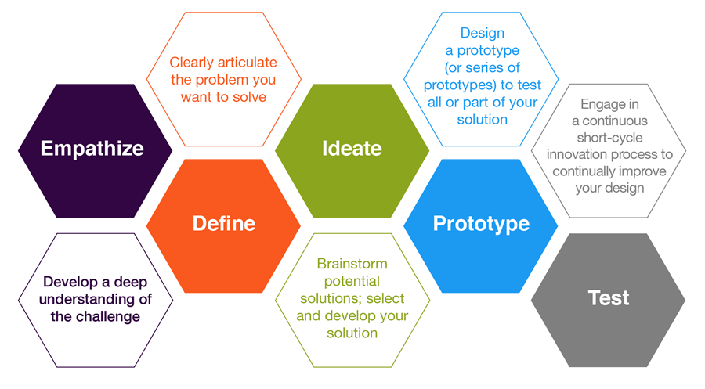
Notes:
https://citl.illinois.edu/paradigms/design-thinking

Slide 13
1.
Empathy
Understanding

Slide 14
Empathy Process
Site Visits
Short Interview
Cohort
Short Interview
Empathy Maps
More on the Cohort
Facilitated In LMS
10 minutes per week of “work”
This group will be our test group and will get new standards first.
Notes:
Empathy Map (Filled Out)

Slide 15
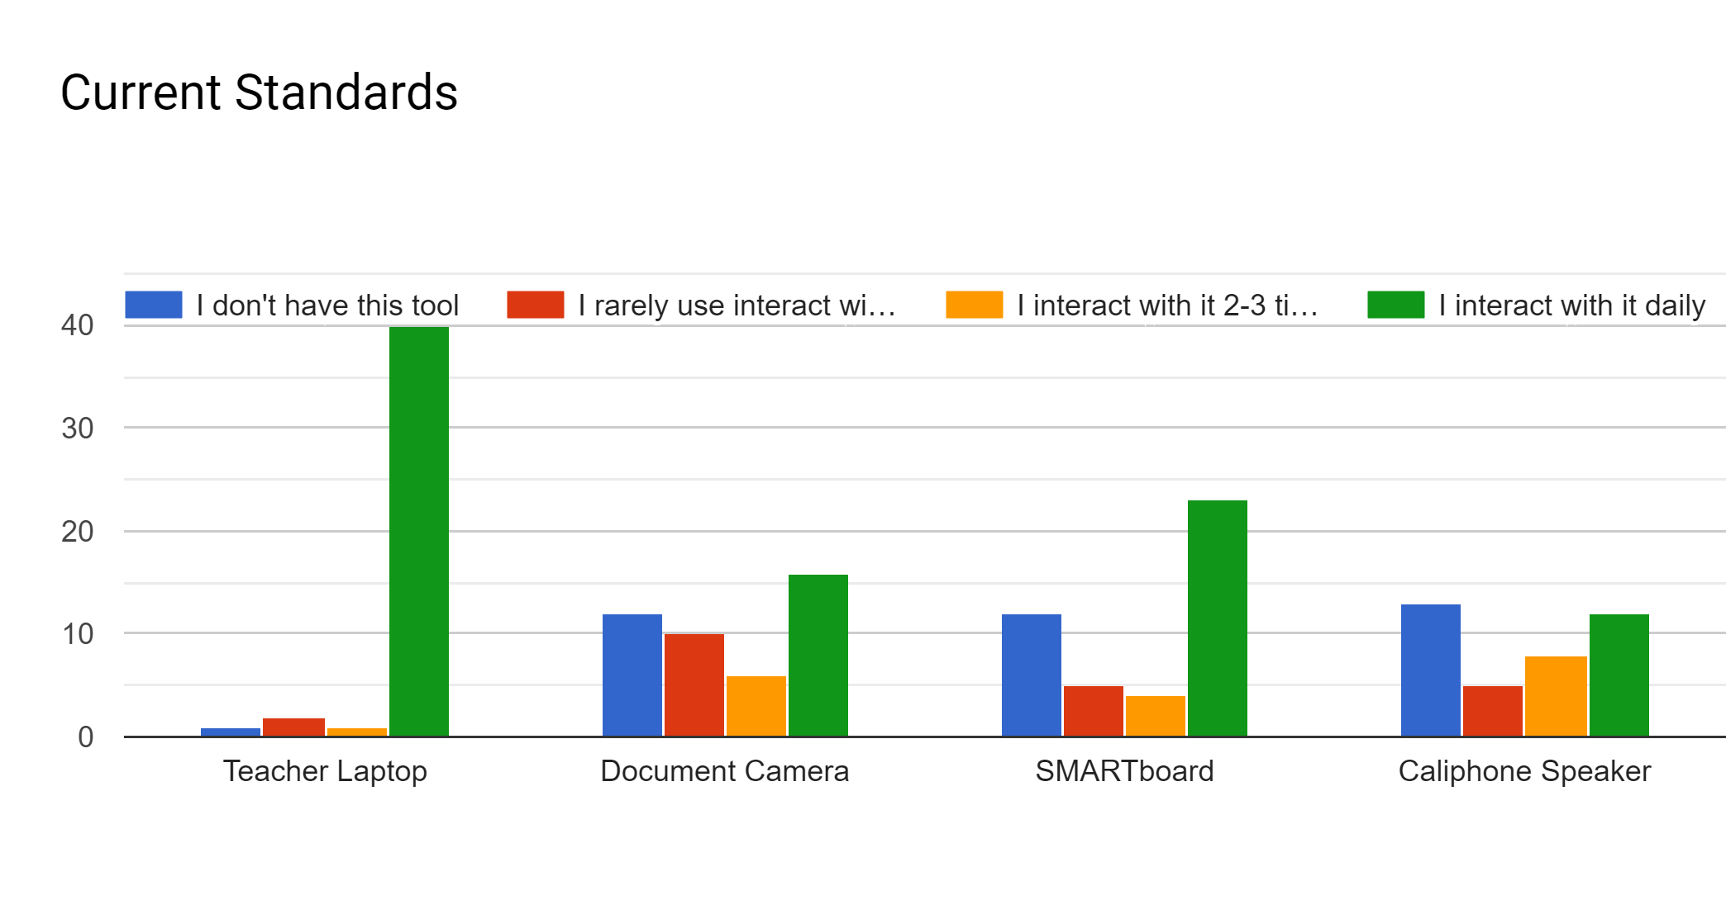

Slide 16
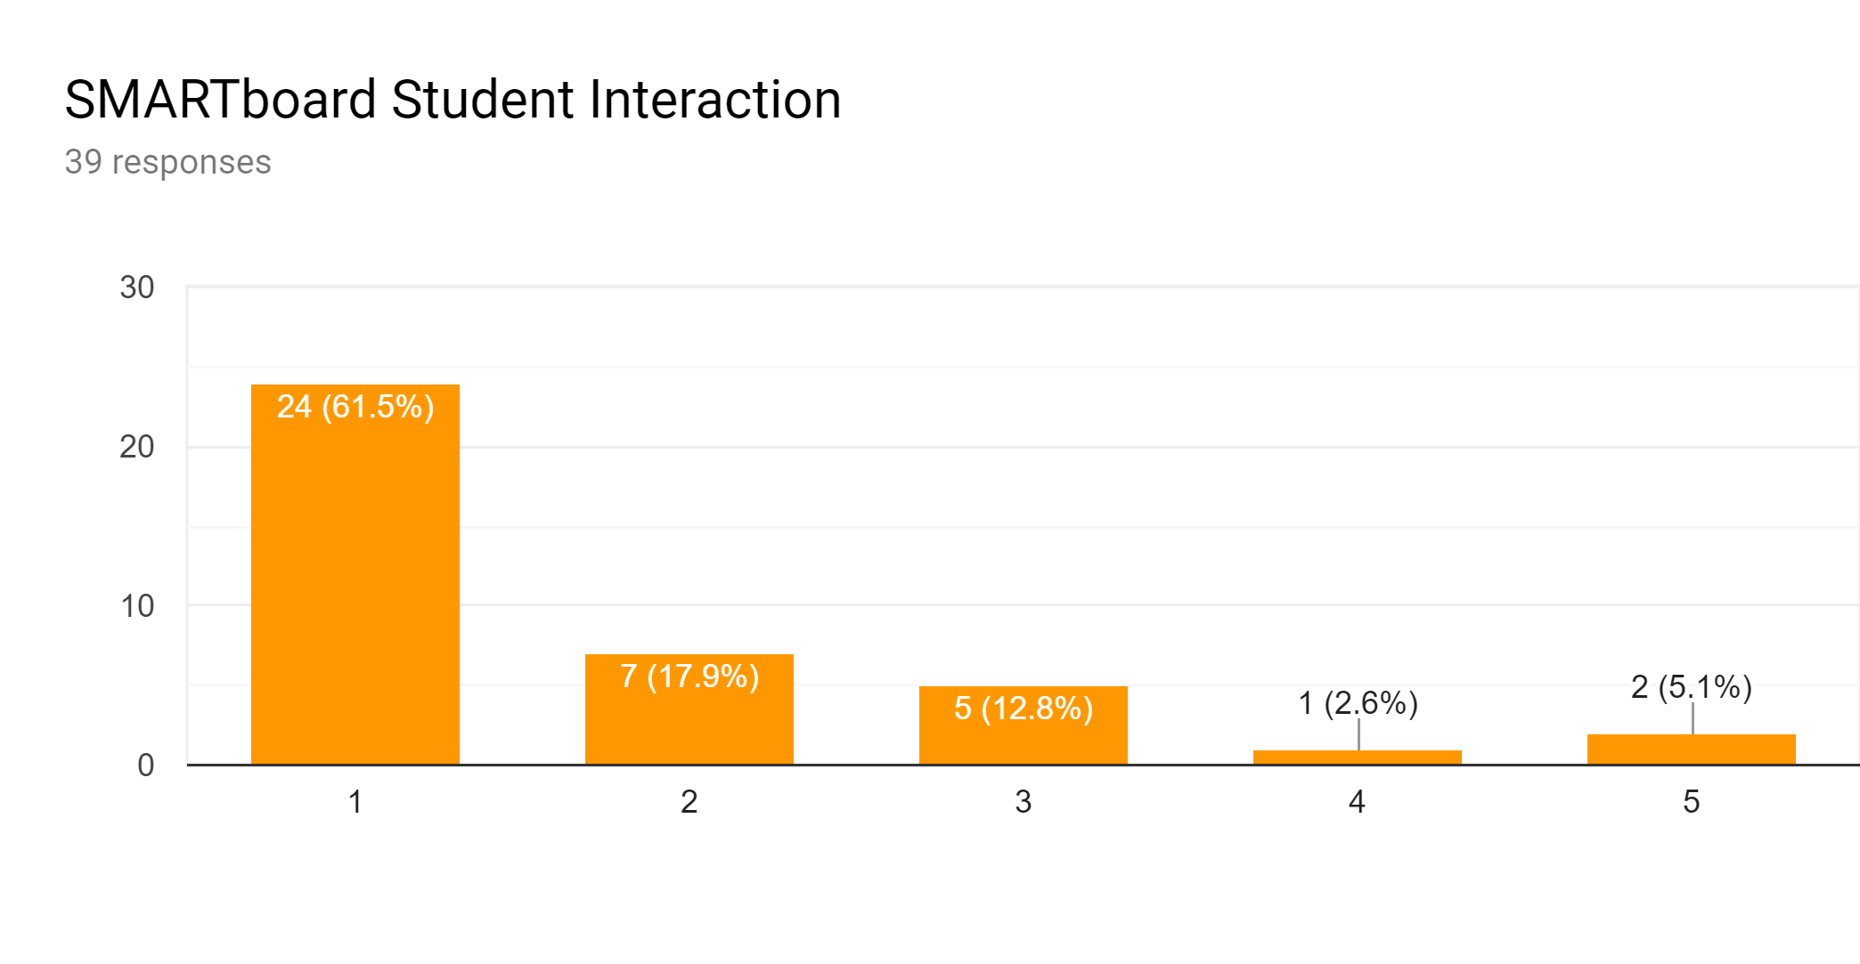

Slide 17
2.
Define
The Problem

Slide 18
Definition Process
Our Tech Steering Committee will curate and record definition statements and utilize those to move us into the Ideate phase.
Definition statements are statements of conclusion from the empathy phase.
Notes:
https://dschool-old.stanford.edu/sandbox/groups/designresources/wiki/36873/attachments/74b3d/ModeGuideBOOTCAMP2010L.pdf

Slide 19
3.
Ideate
Death by 1,000 ideas?

Slide 20
4.
Prototype
Cohort Teachers Get Their Toys

Slide 21
Lenovo L390 2 in 1

Slide 22
5.
Test
Year Long Process of Learning

Slide 23
Repeat
Steps 3-5 With as Many Feasible Ideations as Possible

Slide 24
Watertown Mayer
Richfield

Slide 25
Tolerances
Random hardware leftovers. So what?
Rogue and Shadow IT. How much can you handle?

Slide 26
Considerations
What’s your budget?
What are your T & L department priorities?
What is the 5-10 year plan for physical classroom spaces. Don’t do this work in isolation.

Slide 27
PD and Support
Notes:
Richfield

Slide 28
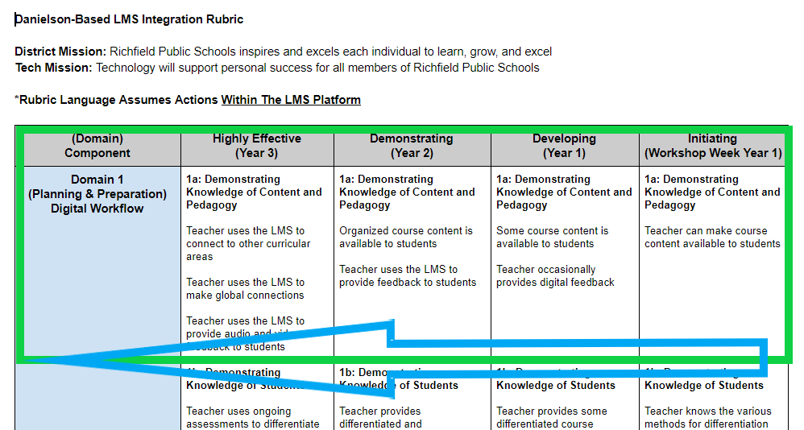
Repeated Processes
Adoption Rubrics
2. Checklists

Slide 29
Multiple Modalities
In Person
Back to School
Modeling
Learning Academies
PD Days
Blended
Learning Academies
Voluntary Cohorts
Online
Learning Academies
Self Paced Courses
Tech Cafes via Hangouts

Slide 30
Richfield
Top PD & Support Tips
Mindset About Training = Importance of Training
Provide Multiple Modalities
Modeling/Pineapple Charts more effective than sit and get!
Standardize creatively. Is there room for choice?

Slide 31
Thanks!
Any questions?

